Slide 1







STACK OVERFLOW DEVELOPER SURVEY 2019
MINA JADAV
February 27/2024

Slide 2



OUTLINE
Executive Summary
Introduction
Methodology
Results
Visualization – Charts
Dashboard
Discussion
Findings & Implications
Conclusion
Appendix

Slide 3

EXECUTIVE SUMMARY
Data contextualization and analysis goal.
•Methodology description.
•Data gathering.
•Data analysis.
•Data visualizations.
•Results presentation supported with graphs and trends.
•Discussion of overall findings and implications regarding the results previously exposed.
•Final conclusions of the carried out research.

Slide 4

INTRODUCTION
Stack Overflow’s annual Developer Survey is the largest and most comprehensive survey of people who code around the world.
•Results don’t represent everyone in the developer community evenly.
Nearly 90,000 developers.
•Trends to predict where the developers are going.
•Characterization of developers around the globe.

Slide 5

METHODOLOGY
•Collect survey data & explore its content
•Web Scraping
•APIs.
•Request library.
•Data Wrangling
•Exploratory data analysis
•Analyzing data distribution.
•Handling outliers.
•Correlations.
•Data Visualization
•Highlight distribution of data, relationships, the composition and comparison of data.
•Dashboards

Slide 6
RESULTS

Slide 7
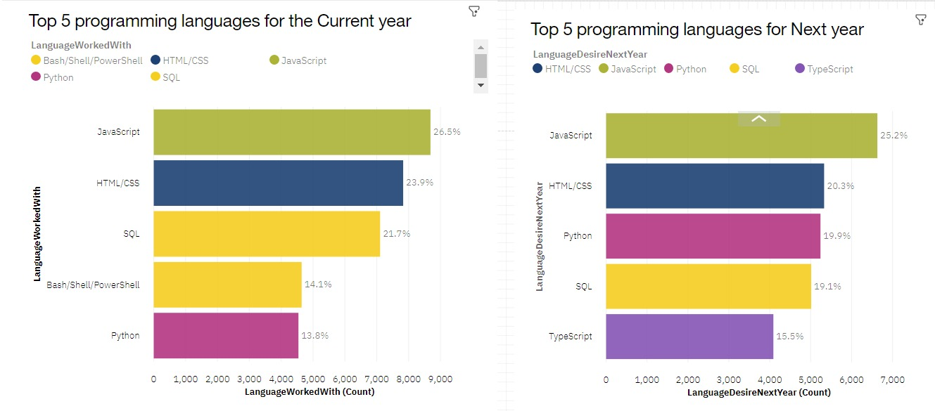
PROGRAMMING LANGUAGE TRENDS
Current Year
Next Year

Slide 8
PROGRAMMING LANGUAGE TRENDS - FINDINGS & IMPLICATIONS
Findings
Implications
Javascript and HTML are used for web development which means that web development as a tech skill has the highest demand, especially as Typescript is getting viral.
Python is gaining more and more traction due to the increase in demand for AI and ML skills.
SQL is the still the most relevant language for data professionals. It is important for aspiring data analysts, scientists, business analysts etc to have SQL skills.
Javascript, HTML/CSS, SQL, Shell languages and Python are the most used languages currently.
Javascript, HTML/CSS, Python, SQL, and Typescript will be the most used languages next year and future years.
Python will have more demand than SQL next year.

Slide 9
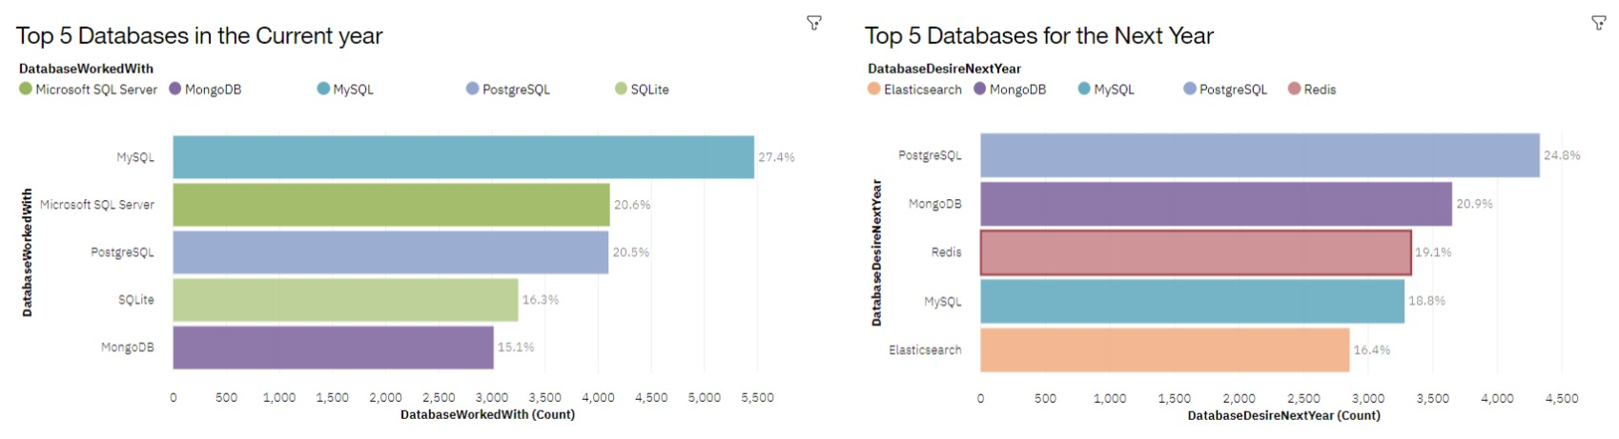
DATABASE TRENDS
Current Year
Next Year

Slide 10
DATABASE TRENDS - FINDINGS & IMPLICATIONS
Findings
MySQL, Microsoft SQL server, Postgre SQL, SQLite and MongoDB are the top 5 most used databases at the moment.
However, Postgre SQL, MongoDB, Redis, MySQL and Elasticsense are projected to become more popular in the future.
Redis and Elasticsense are relaatively new tools and are set to gain more traction in the IT space.
Implications
SQL is still a top tool to watch out for in data specialists.
Companies still prefer Open source databases.
Oracle SQL was not among the top 5. It is losing relevance as time passes.

Slide 11

DASHBOARD
The permanent link of the Cognos dashboard:
https://github.com/MinaJadav/testtepro

Slide 12
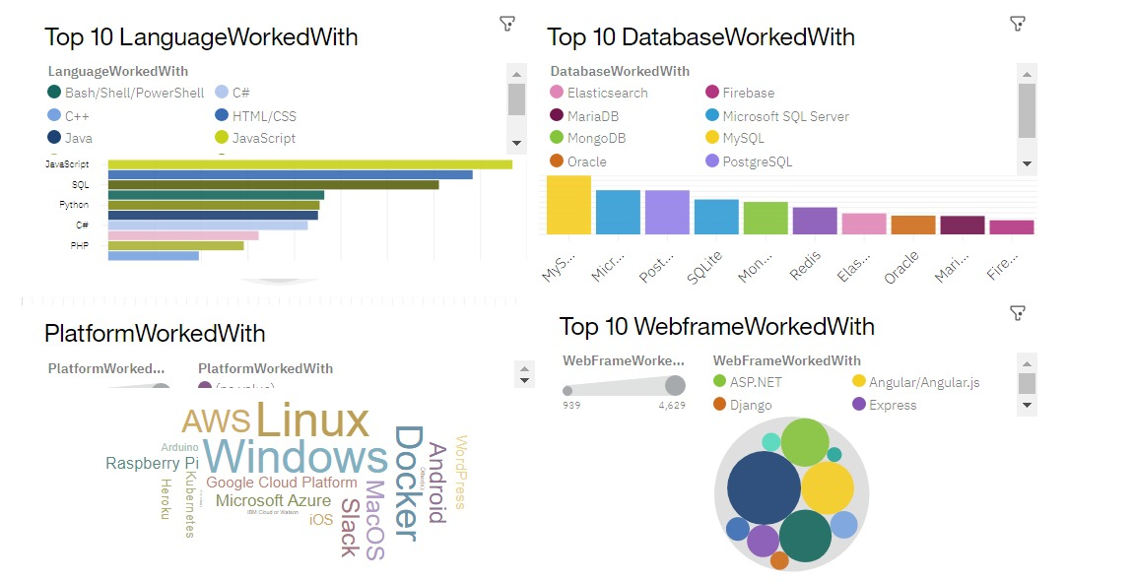
DASHBOARD TAB 1

Slide 13
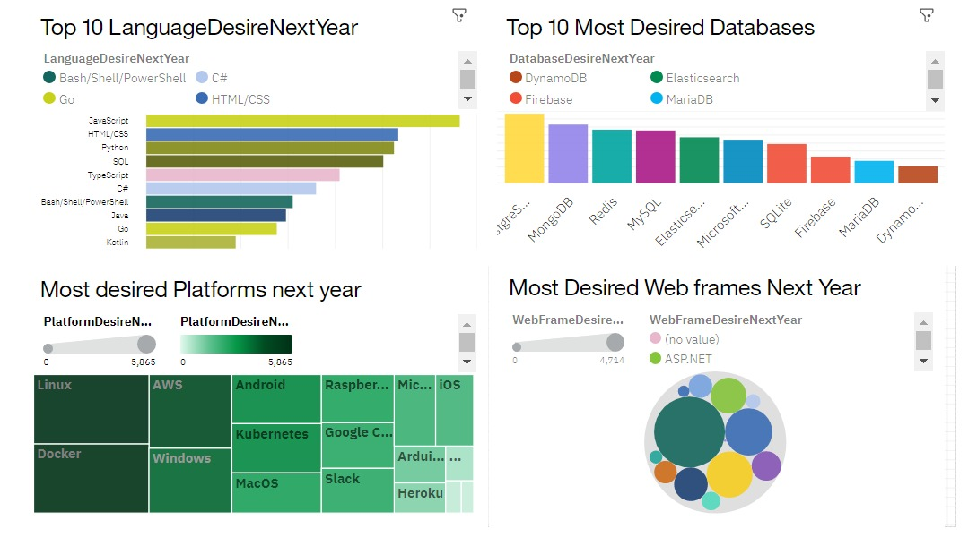
DASHBOARD TAB 2

Slide 14
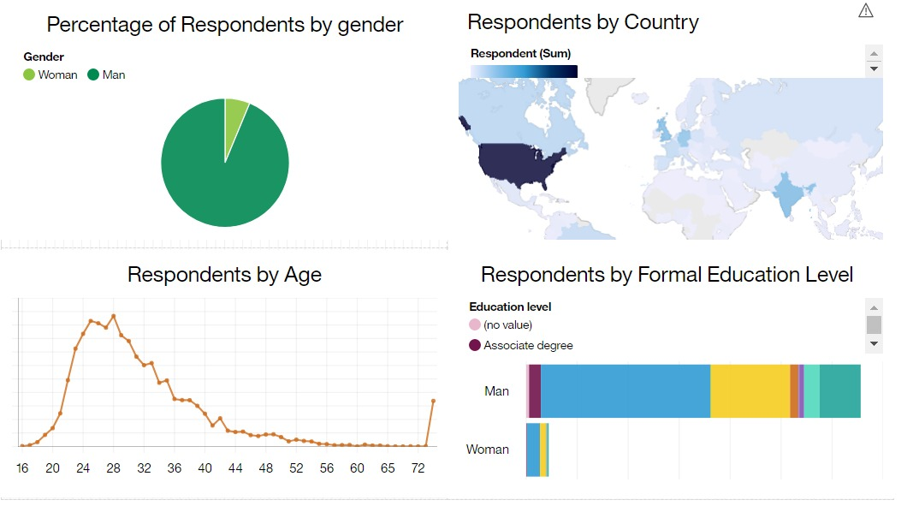
DASHBOARD TAB 3

Slide 15
DISCUSSION
Upskilling in the Technology sector.
How do we close the wide gender gap in the Technology sector?
Is completing a masters or doctorate degree really a requirement?
The increasing demand for mobile development as Kotlin is getting popular.
More tech education, access and development in less developed regions in South east Asia, South America, Africa and some parts of Europe.
How relevant will Oracle SQL still be in the future?

Slide 16
OVERALL FINDINGS & IMPLICATIONS
Findings
Findings
•JavaScript widely used and TypeScript getting popular.
•Over 90% young male developers.
•Developers mostly located in developed countries.
Implications
•JavaScript and TypeScript web frames gaining followers.
•Global polarization of developers location and gender.
•Young developers without postgrad studies on its majority.

Slide 17

CONCLUSION
Developers are people with very marked characteristics.
A good idea of popularity trends of different tools, platforms and languages can be obtained.
There is a job to be done to spread accessibility of this labor market to countries in development.

Slide 18

APPENDIX
Include any relevant additional charts, or tables that you may have created during the analysis phase.

Slide 19
JOB POSTINGS

Slide 20
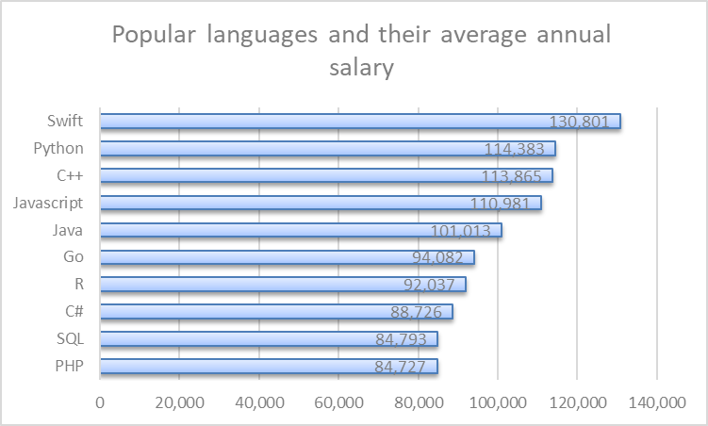
POPULAR LANGUAGES

